Slide 1

CASE WESTERN RESERVE UNIVERSITY
NeurEX
We study and make neurotech
https://case-neurex.vercel.app/

Slide 2


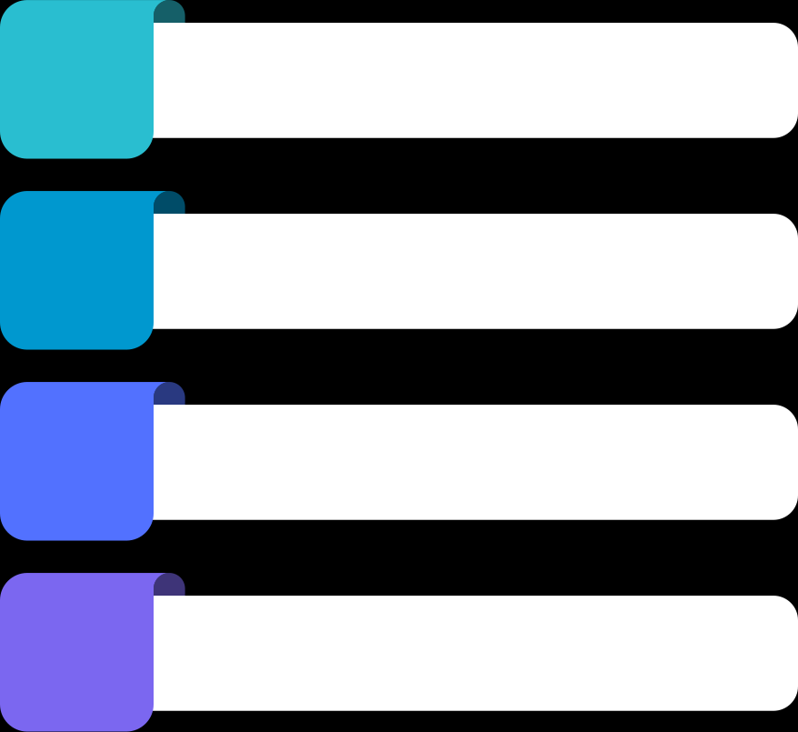
About us
In NeurEX, YOU have opportunity to:
Hands-on learning
Gain project experience
Technical skills
Career Network

Slide 3


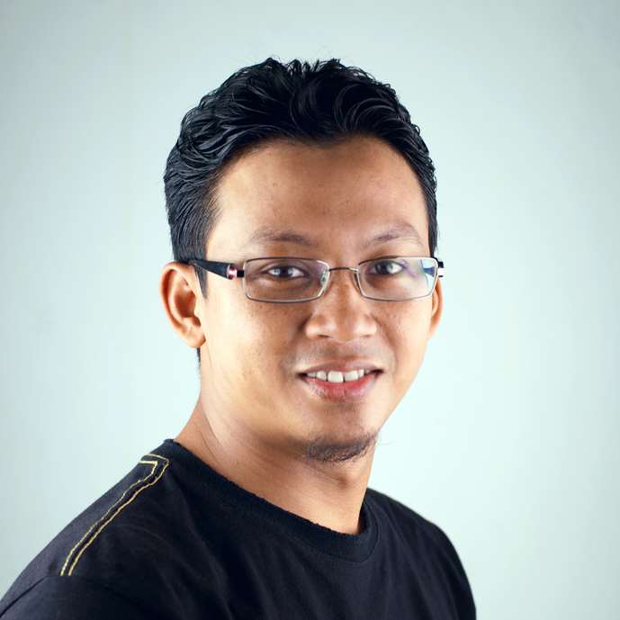
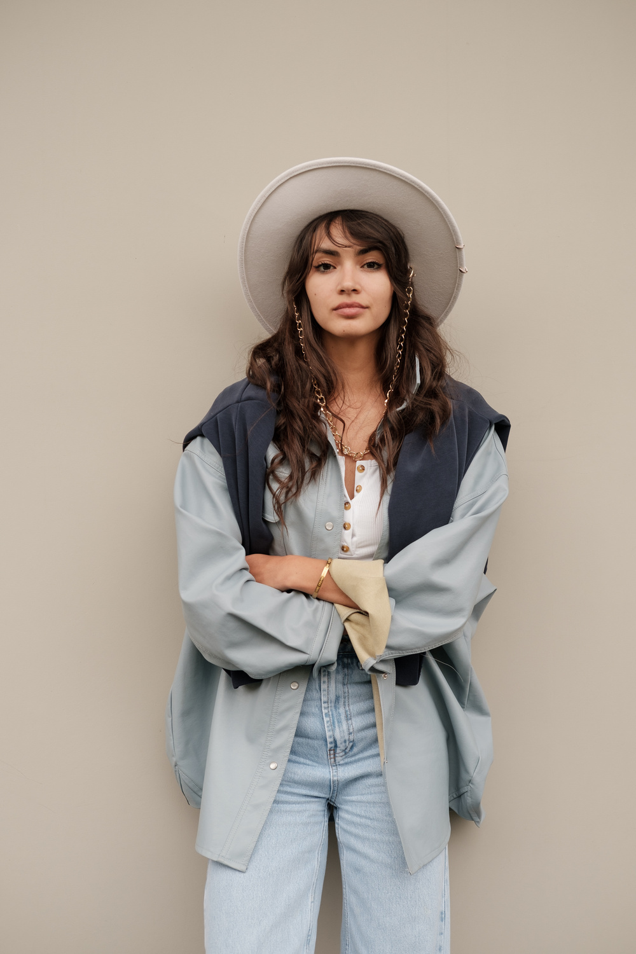
Our Team
Hannah Morales
Aaron Loeb
Muhammad Patel
Claudia Alves
Project manager
Project manager
Project manager
Project manager

Slide 4

Learning
01
We Teach
Neural Modeling
Signal Processing
Deep Learning
Circuit and device intrumentation

Slide 5



We provide support
Mentors Teaching
Learning Materials
Project Shadowing

Slide 6
Building
02
We Build
Projects
Studies
Industry Knowledge

Slide 7
Connections
03
We Network
Guest Speakers from industry
Entrepreneurship
Career Opportunities

